Slide 1
Karnali River in Nepal
By Jeremy Ryan and Jennifer Warren
Notes:
1

Slide 2
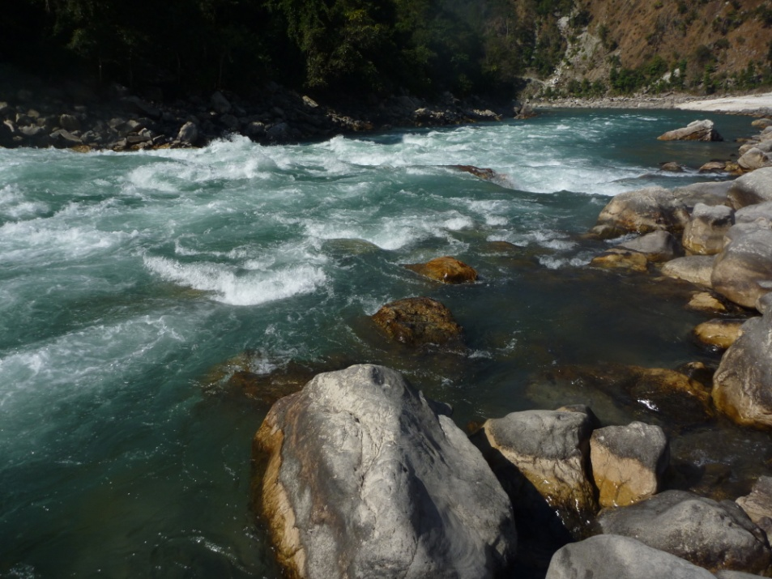
Karnali River - Facts
Karnali River in Nepal by Jeremy Ryan and Jennifer Warren
Located in Far Western Nepal
Name means “Holy Water from the Sacred Mountain”
Flows from Mt. Kailash
Largest and longest river in Nepal
Grade V
actually more like IV or IV+
10 day trip
Put In – village of Sauli
Take Out – town of Chisapani
110 miles
Flow – approximately 20,000 cfs
Rapid names
Captivity
Flip & Strip
God’s House
Sweetness & Light

Slide 3
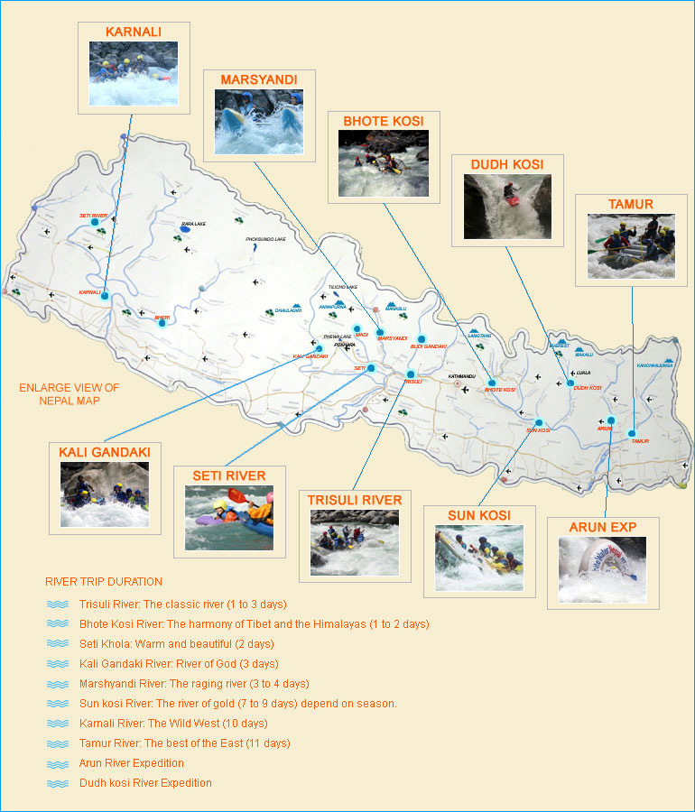
Other Nepali Rivers
Karnali River in Nepal by Jeremy Ryan and Jennifer Warren
Marsghandi (Marsyandi)
Grade V-
3 days
Seti
Grade III+
2 days
Kali Ghandaki
Grade IV+
3 days
Trisuli
Grade IV
1 to 3 days
Sun Kosi
Grade V
7 to 9 days
Ton of first descents!!!

Slide 4
Map of Nepal
Karnali River in Nepal by Jeremy Ryan and Jennifer Warren

Slide 5
Map of Karnali River
Karnali River in Nepal by Jeremy Ryan and Jennifer Warren

Slide 6
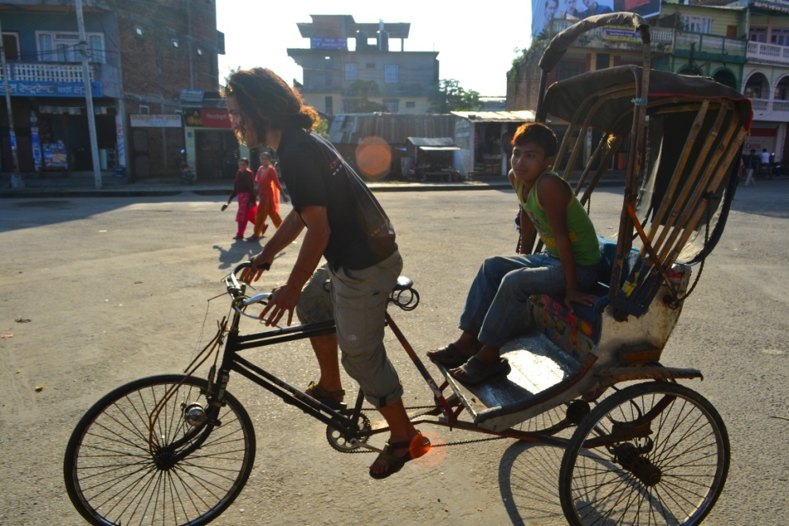
Karnali River in Nepal by Jeremy Ryan and Jennifer Warren
Bus Journey

Slide 7
Karnali River in Nepal by Jeremy Ryan and Jennifer Warren
Mass Transit

Slide 8
Karnali River in Nepal by Jeremy Ryan and Jennifer Warren
Put In

Slide 9
Karnali River in Nepal by Jeremy Ryan and Jennifer Warren

Slide 10
Karnali River in Nepal by Jeremy Ryan and Jennifer Warren
Notes:
10

Slide 11
Karnali River in Nepal by Jeremy Ryan and Jennifer Warren
Notes:
11

Slide 12
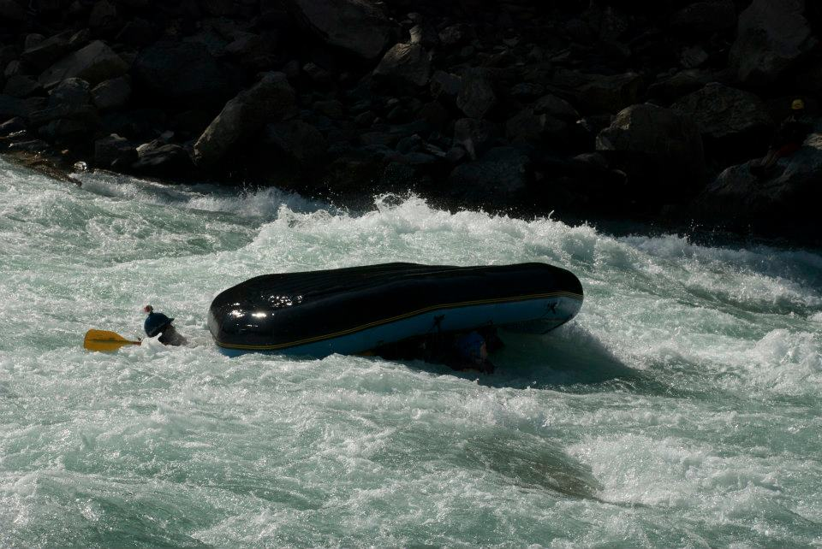
Carnage
Rapid – Sweetness & Light
Grade IV - V

Slide 13
Karnali River in Nepal by Jeremy Ryan and Jennifer Warren
Notes:
13

Slide 14
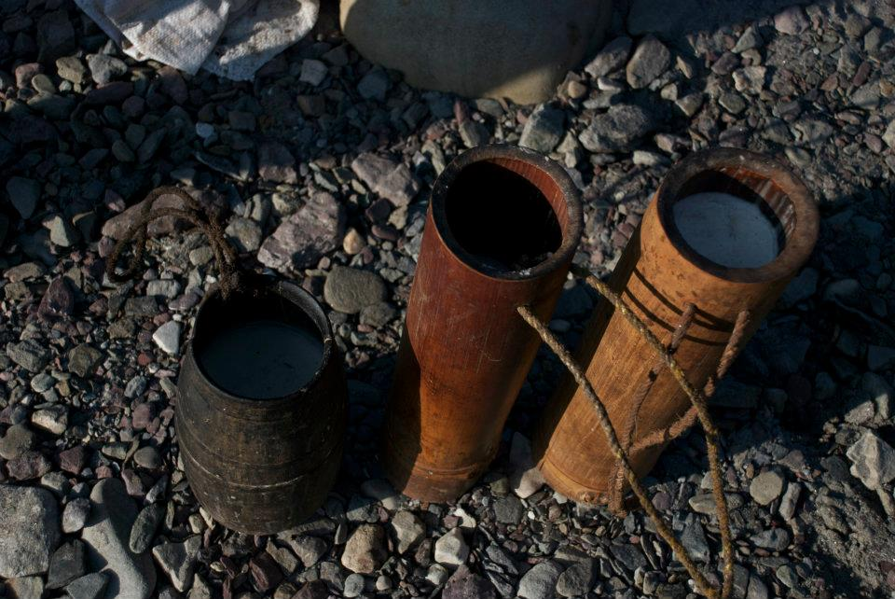
Nepali Villagers

Slide 15
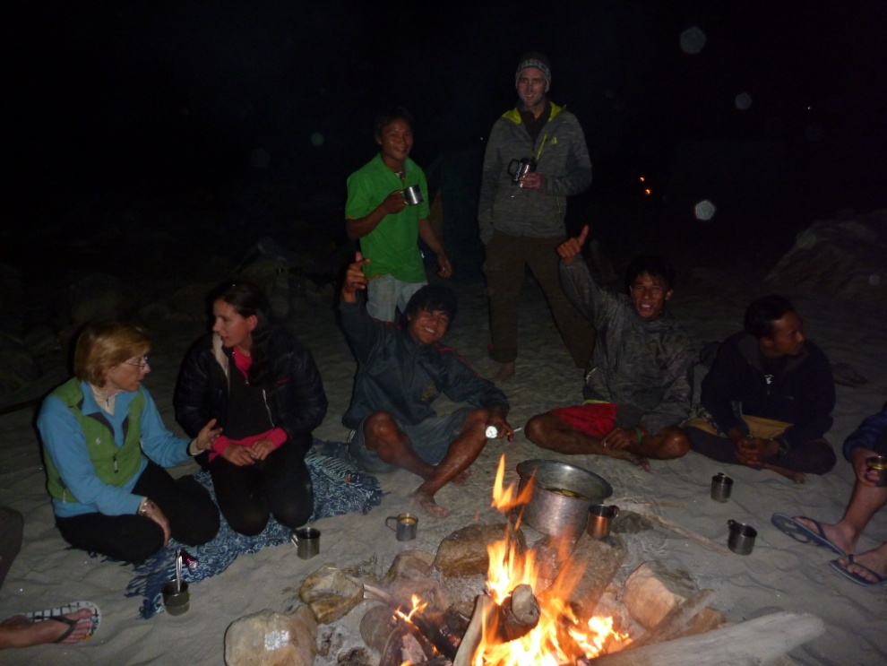
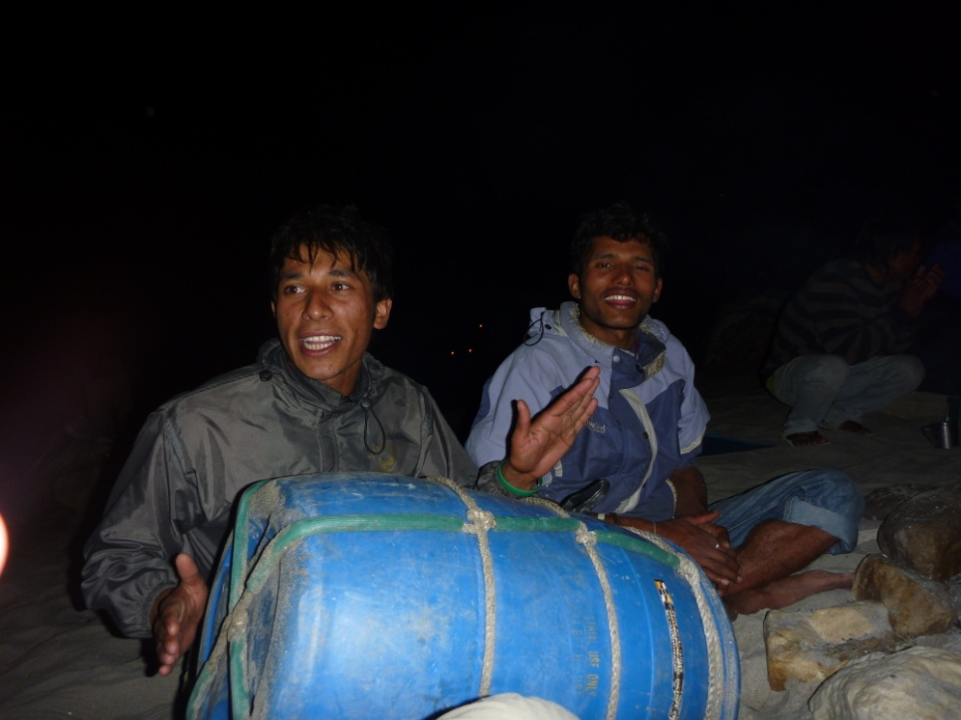
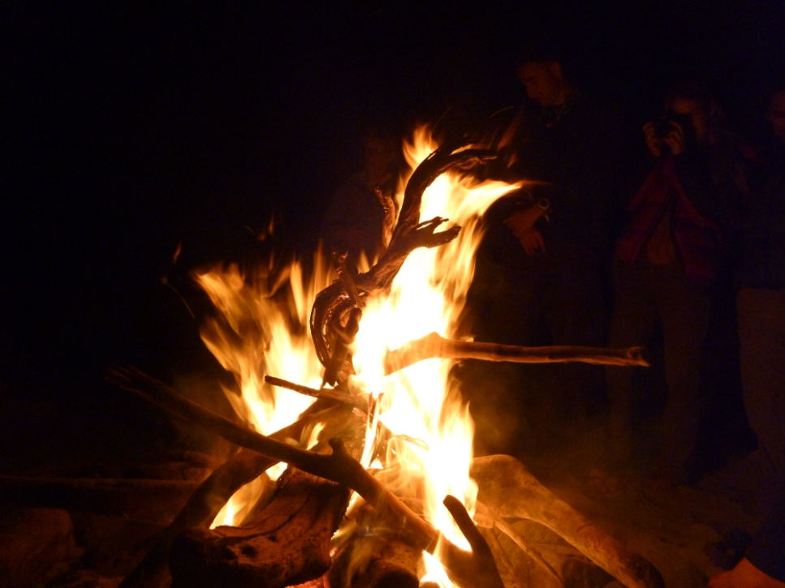
Campfire, Entertainment & Libations
Notes:
15

Slide 16
Karnali River in Nepal by Jeremy Ryan and Jennifer Warren
Notes:
16

Slide 17
Karnali River in Nepal by Jeremy Ryan and Jennifer Warren
Notes:
17

Slide 18
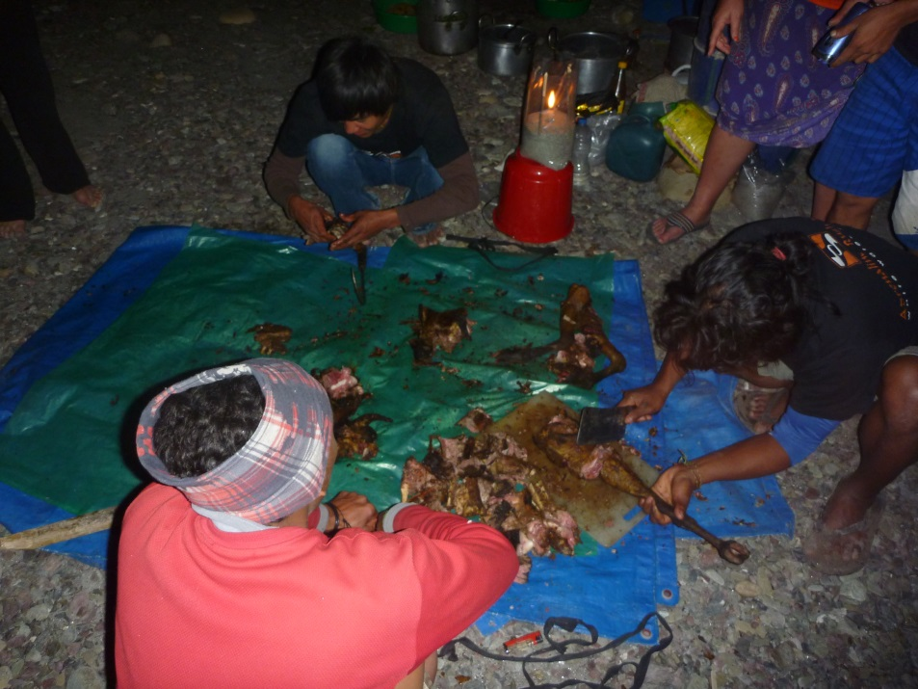
Goat- Its What’s For Dinner…For Four Days

Slide 19
Karnali River in Nepal by Jeremy Ryan and Jennifer Warren
Notes:
19

Slide 20
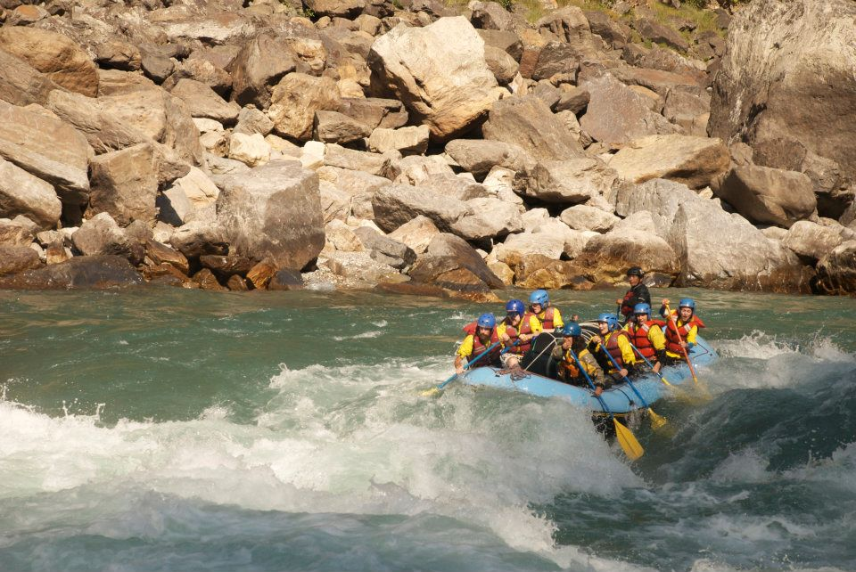

Slide 21
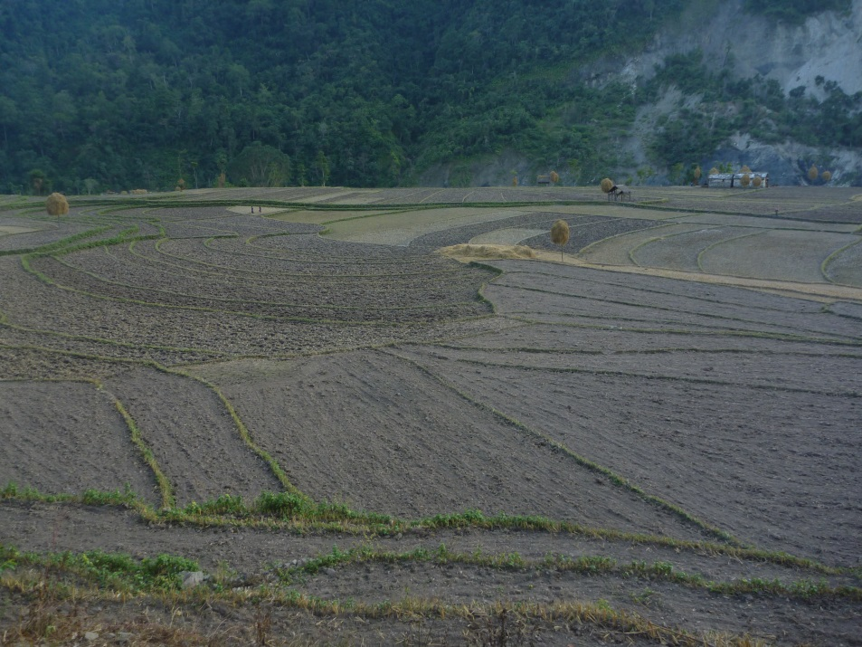
Nepali Villages

Slide 22
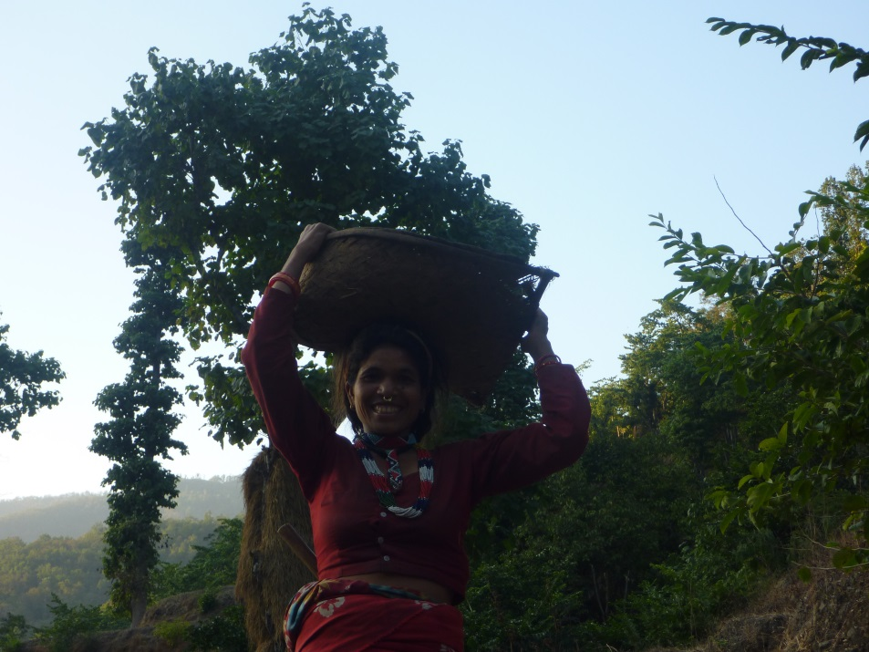
Nepali Villagers

Slide 23
Karnali River in Nepal by Jeremy Ryan and Jennifer Warren
Notes:
23

Slide 24
God’s House

Slide 25
Karnali River in Nepal by Jeremy Ryan and Jennifer Warren
Notes:
25

Slide 26
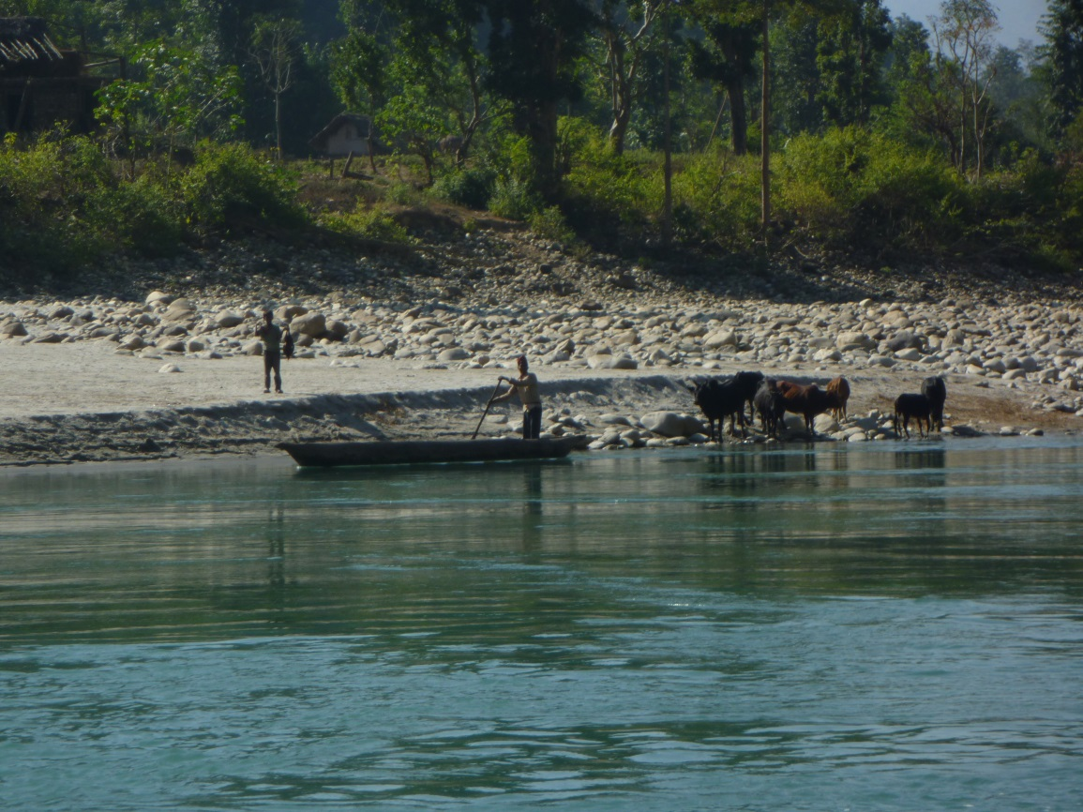
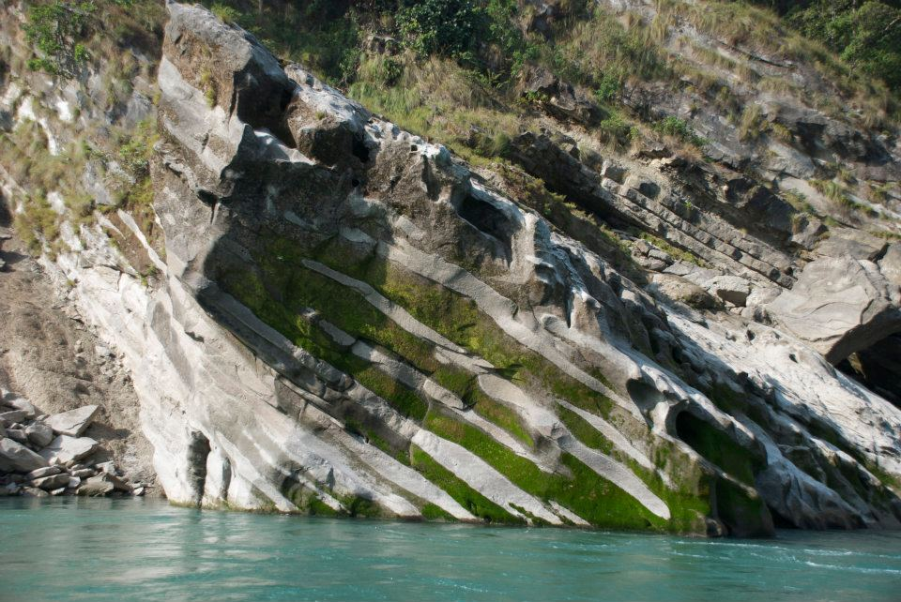
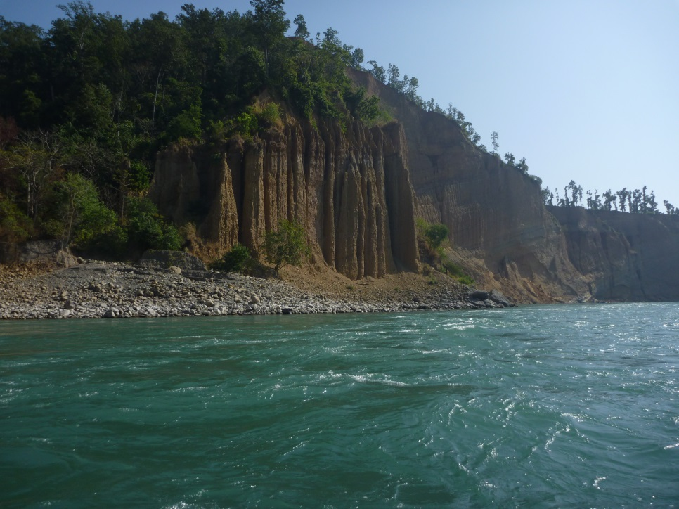
Flat Water
Notes:
26

Slide 27
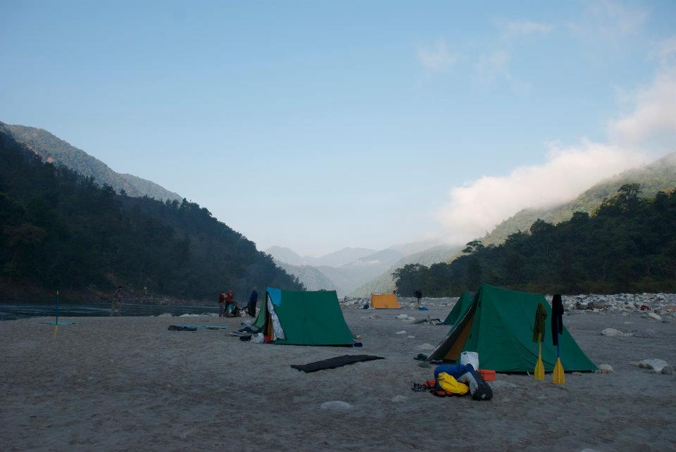
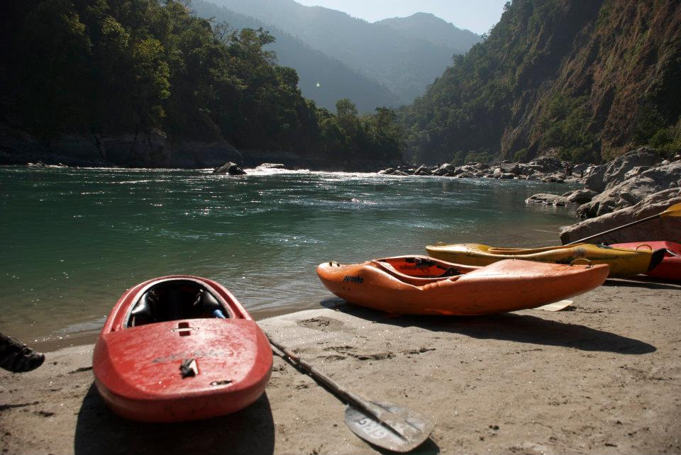
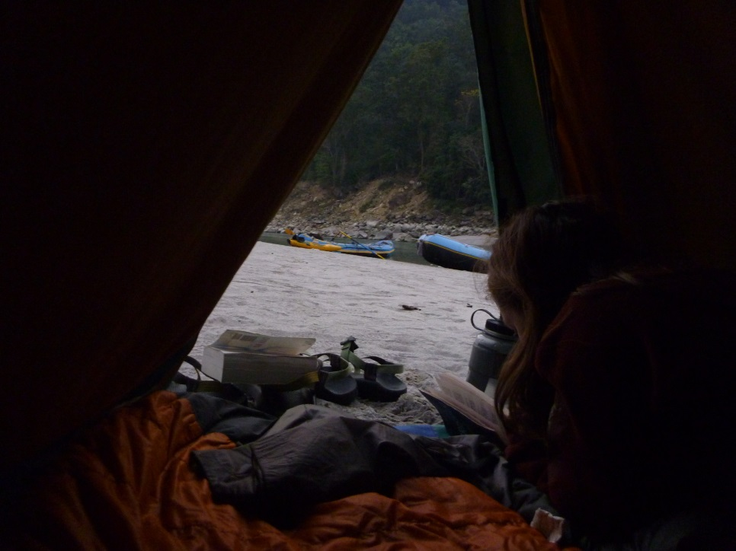
Relaxin’
Notes:
27

Slide 28
Nepali Villagers

Slide 29
WTF?

Slide 30
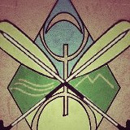
The End
Questions?
Our fearless guide, Yann Coppen
Berber Rafting Adventures
https://www.facebook.com/#!/pages/Berber-Rafting-Adventures/114613361988919?fref=ts
Notes:
30

